Slide 1
Multiview Geometry
Reading:
[AZ] Chapter: 4 “Estimation – 2D perspective transformations
Chapter: 9 “Epipolar Geometry and the Fundamental Matrix Transformation”
Chapter: 11 “Computation of the Fundamental Matrix F”
[FP] Chapter: 7 “Stereopsis”
Chapter: 8 “Structure from Motion”
Some slides in this lecture are courtesy to Prof. Silvio Savarese

Slide 2
Agenda
Why is stereo useful?
Epipolar constraints
Fundamental matrix
Estimating F

Slide 3
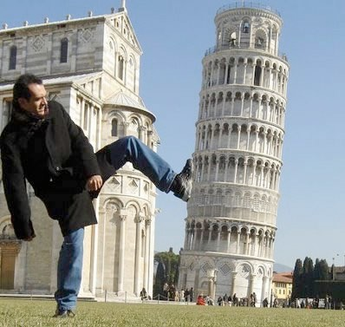
Recovering structure from a single view
Intrinsic ambiguity of the mapping from 3D to image (2D)
Courtesy slide S. Lazebnik

Slide 4

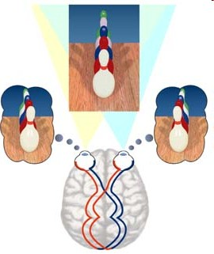
Two eyes help!

Slide 5
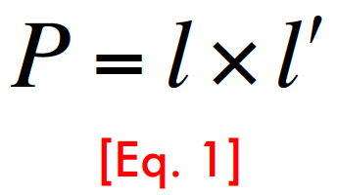




Two eyes help!
P
l'
l
p’
p
K =known
K’ =known
R, T
O₁
O₂
This is called triangulation

Slide 6

Triangulation
Find P* that minimizes
d( p, M P*)+ d( p', M ' P*)
[Eq. 2]
P
P*
MP*
M’P* _{p’}
p
O₁
O₂

Slide 7
Multi (stereo)-view geometry
Camera geometry: Given corresponding points in two images, find camera matrices, position and pose.
Scene geometry: Find coordinates of 3D point from its projection into 2 or multiple images.
Correspondence: Given a point p in one image, how can I find the corresponding point p’ in another one?

Slide 8
Agenda
Why is stereo useful?
Epipolar constraints
Fundamental matrix
Estimating F

Slide 9
Epipolar geometry
P
p
p’
e
e’
O₁
O₂
• Epipolar Plane • Epipoles e, e’
• Baseline = intersections of baseline with image planes
_{• Epipolar Lines} = projections of the other camera center

Slide 10
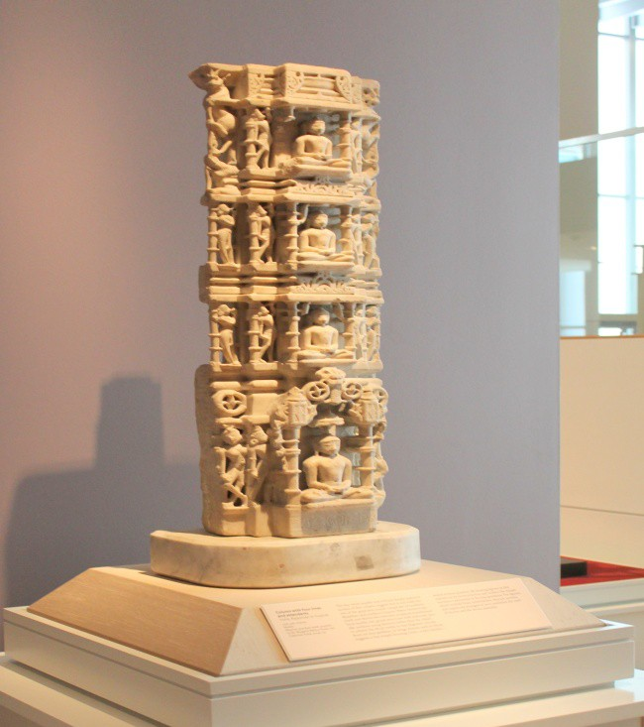
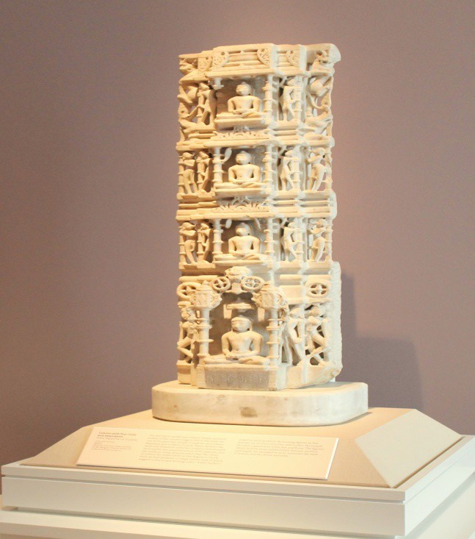
Example of epipolar lines

Slide 11
Example: Parallel image planes
P
v
v
e
e’
p
p’
u
u
O₁
O₂
Baseline intersects the image plane at infinity
Epipoles are at infinity
Epipolar lines are parallel to u axis

Slide 12
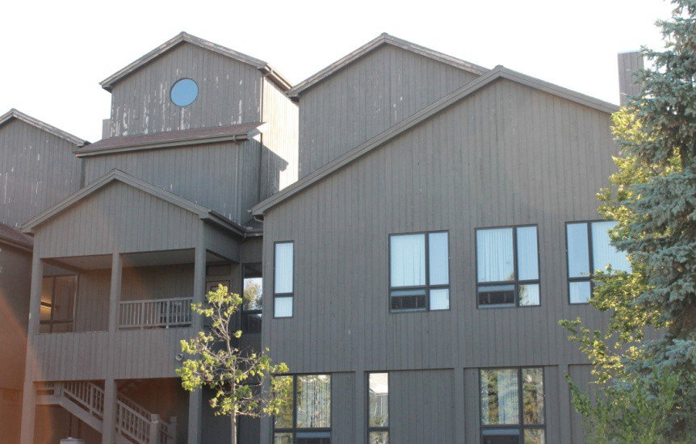
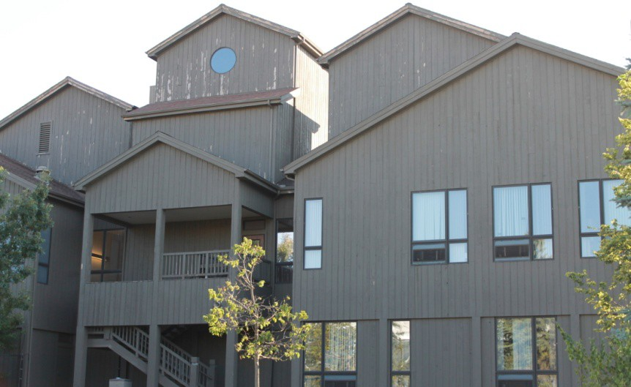
Example: Parallel Image Planes

Slide 13
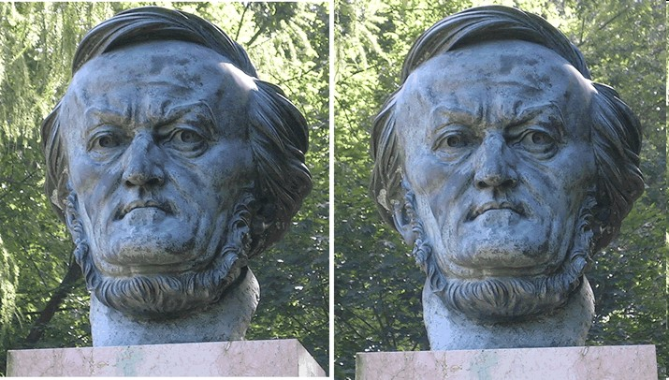

Epipolar Constraint
Where is p’?
p
Two views of the same object
Given a point on left image, how can I find the corresponding point on right image?

Slide 14
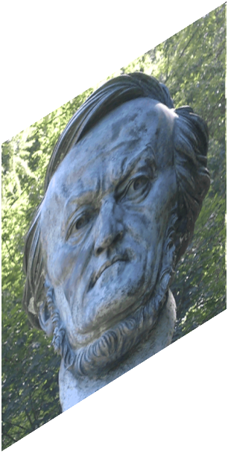
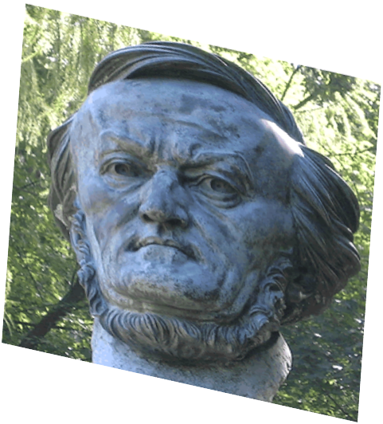
Epipolar geometry
P
Epipolar line 2
p
p’
O₁
O₂

Slide 15
Epipolar Constraint
Epipolar line 2
p
p’

Slide 16

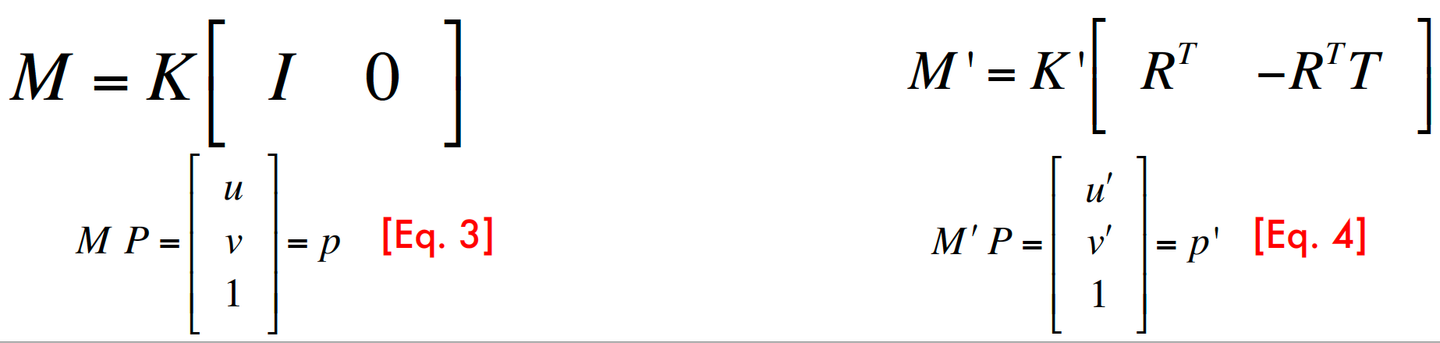
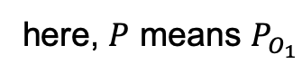
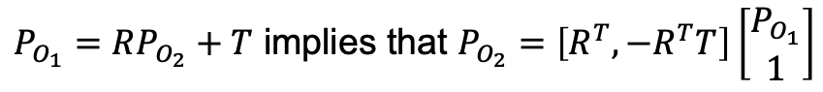
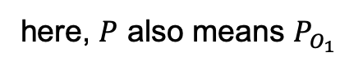
Epipolar Constraint
$P_{O_{1}}=RP_{O_{2}}+T$ implies that $P_{O_{2}}=\left[R^{T},−R^{T}T\right]\left[\begin{aligned}P_{O_{1}} \\ 1\end{aligned}\right]$
v
p’
p
u
O₁
R, T
O₂
here, $P$ means $P_{O_{1}}$
here, $P$ also means $P_{O_{1}}$

Slide 17
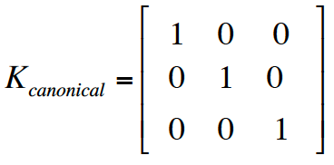
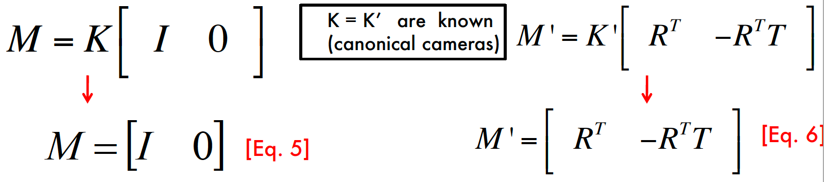
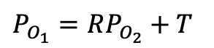
Epipolar Constraint
$P_{O_{1}}=RP_{O_{2}}+T$
p’
p
O₁
R, T
O₂

Slide 18
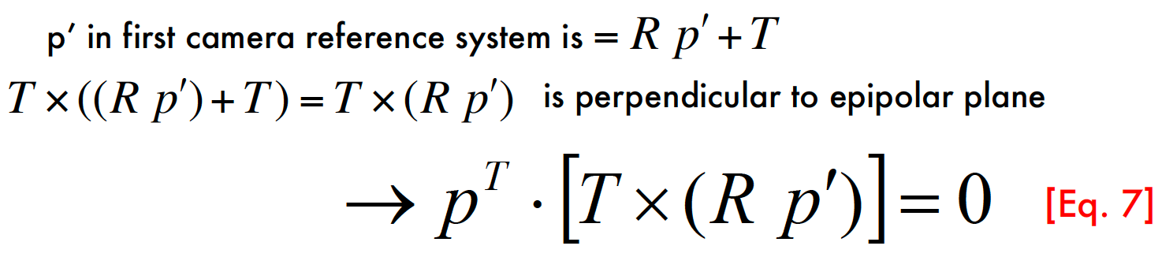
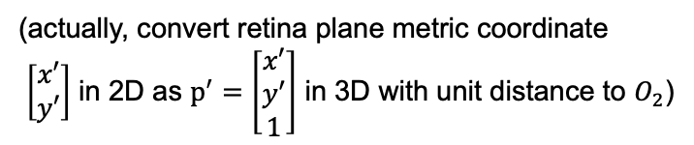
Epipolar Constraint
$P_{O_{1}}=RP_{O_{2}}+T$
p’
p
O₁
R, T
O₂
(actually, convert retina plane metric coordinate
$\left[\begin{aligned}x′ \\ y′\end{aligned}\right]$ in 2D as $p^{′}=\left[\begin{aligned}x′ \\ y′ \\ 1\end{aligned}\right]$ in 3D with unit distance to $O_{2}$)

Slide 19
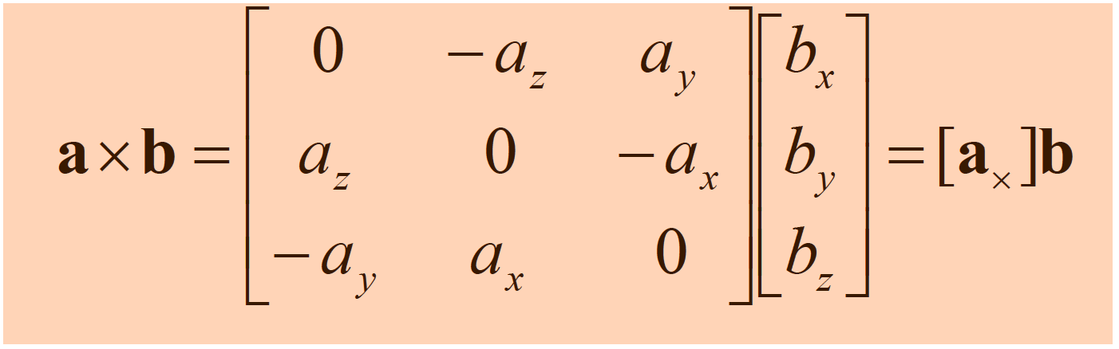
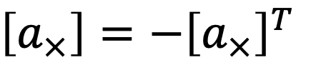
Cross product as matrix multiplication
$\left[a_{×}\right]=−{\left[a_{×}\right]}^{T}$
“skew-symmetric matrix”

Slide 20
Epipolar Constraint
P
p’
p
O₁
R, T
O₂
p^{T} ⋅ [T ×(R p′)]= 0 →
[Eq. 8]
p^{T} ⋅ [T×]⋅R p′ = 0
[Eq. 9]
E = Essential matrix
(Longuet-Higgins, 1981)

Slide 21


Epipolar Constraint
P
p^{T} ⋅ E p' = 0
[Eq. 10]
p
p’
l
l’
e
e’
O₁
O₂
• l = E p’ is the epipolar line associated with p’
• l’ = E^{T} p is the epipolar line associated with p
• E e’ = 0 and E^{T} e = 0
• E is 3x3 matrix; 5 DOF
• E is singular (rank two)

Slide 22
Agenda
Why is stereo useful?
Epipolar constraints
Fundamental matrix
Estimating F

Slide 23
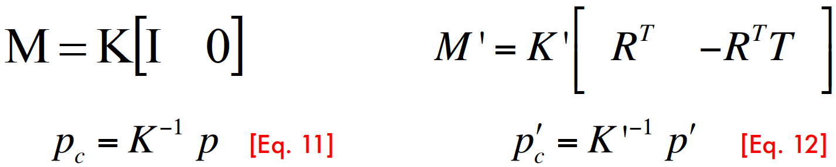
Epipolar Constraint
P
p’
p
R, T
O₂
“ideal” camera
Goal: Cancel the adjustment made by $K$ which was to accommodate the device

Slide 24
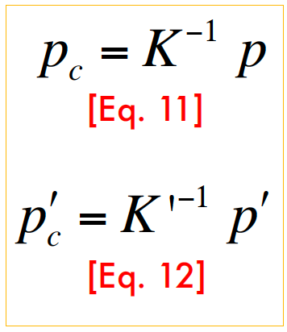
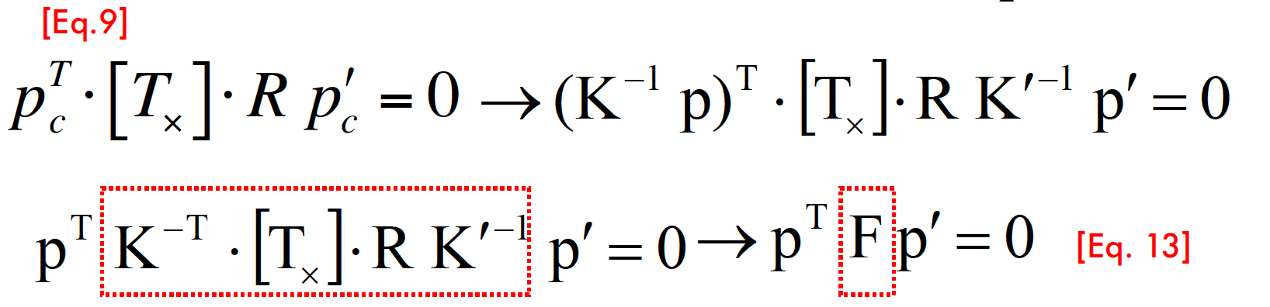
Epipolar Constraint
p’
p
O₁
O₂

Slide 25
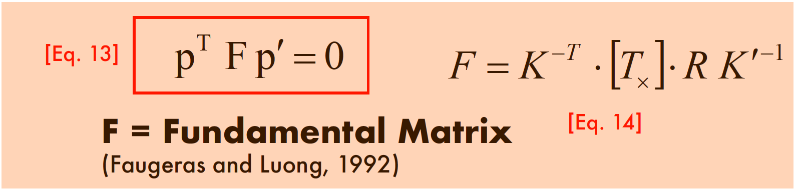
Epipolar Constraint
P
p’
p
O₁
O₂

Slide 26
Epipolar Constraint
p^{T} ⋅ F p' = 0
P
p
p’
l
l’
e
e’
O₁
O₂
• l = F p’ is the epipolar line associated with p’
• l’= F^{T} p is the epipolar line associated with p
• F e’ = 0 and F^{T} e = 0
• F is 3x3 matrix; 7 DOF
• F is singular (rank two)

Slide 27
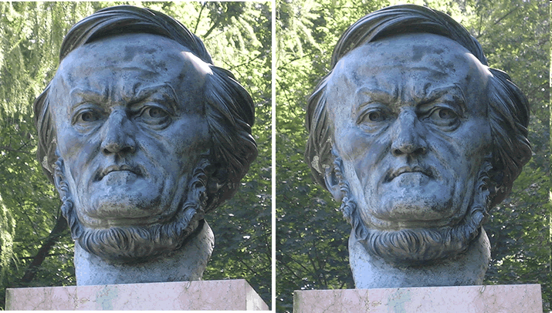
Why F is useful?
l’ = F^{T} p
p
p’
Suppose F is known
No additional information about the scene and camera is given
Given a point on left image, we can compute the corresponding epipolar line in the second image

Slide 28
Why F is useful?
F captures information about the epipolar geometry of 2 views + camera parameters
MORE IMPORTANTLY: F gives constraints on how the scene changes under view point transformation (without reconstructing the scene!)
Powerful tool in:
3D reconstruction
Multi-view object/scene matching

Slide 29
Agenda
Why is stereo useful?
Epipolar constraints
Fundamental matrix
Estimating F

Slide 30

Estimating F
The Eight-Point Algorithm
(Longuet-Higgins, 1981)
P
(Hartley, 1995)
p’
p
O₁
O₂
p^{T} F p′ = 0

Slide 31
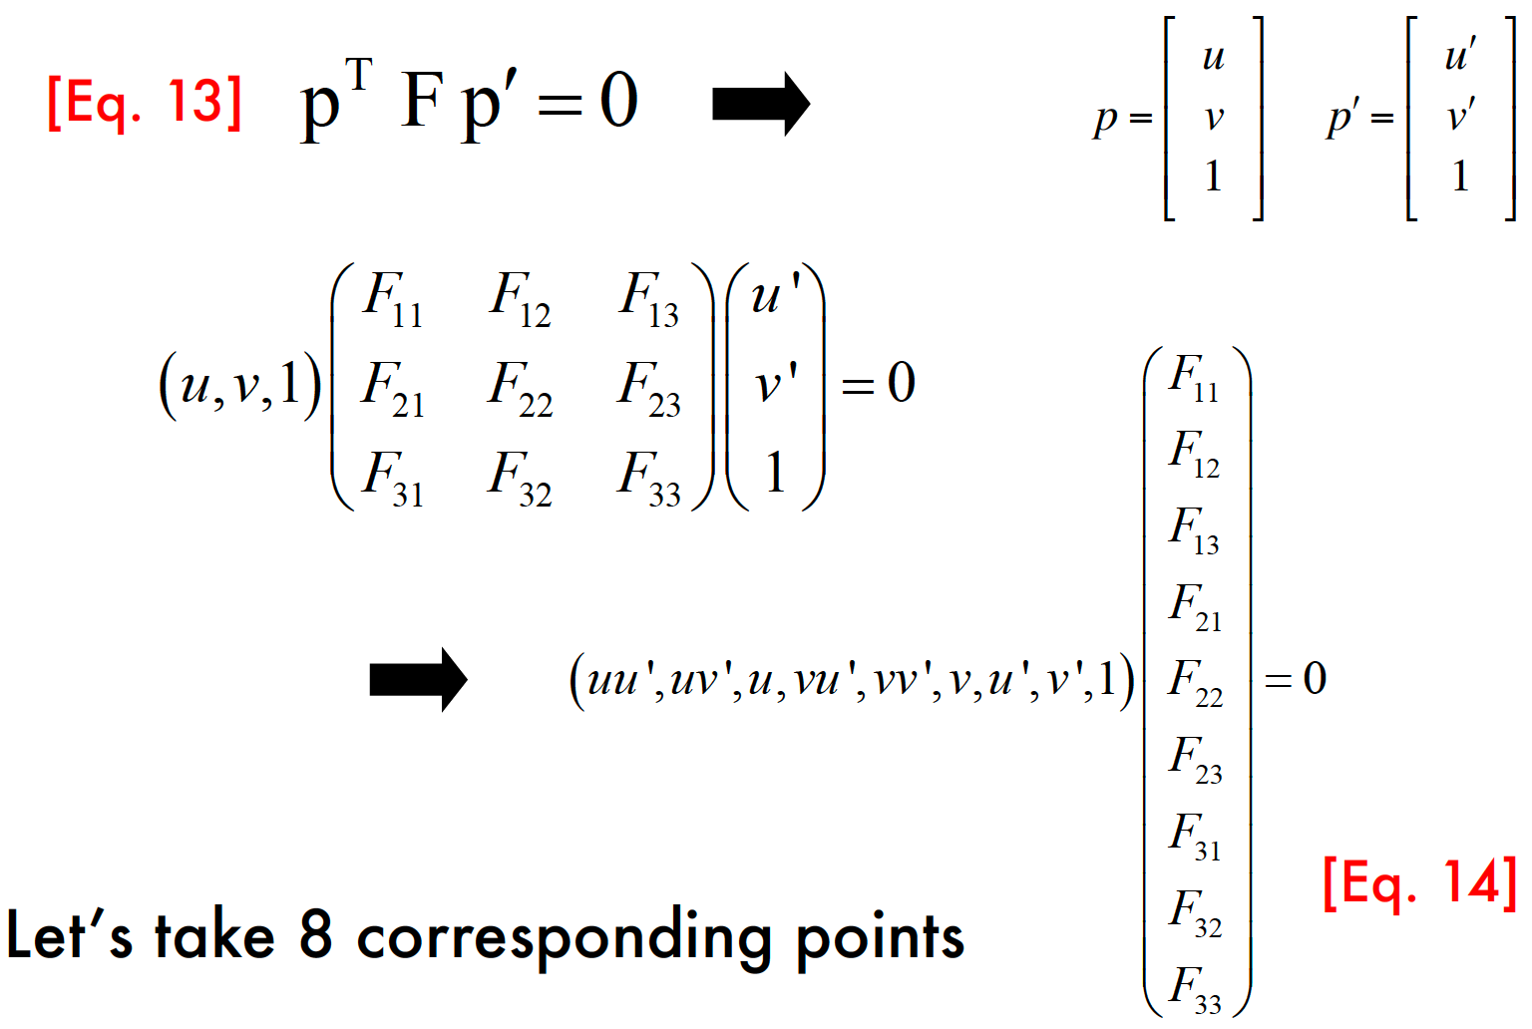
Estimating F

Slide 32
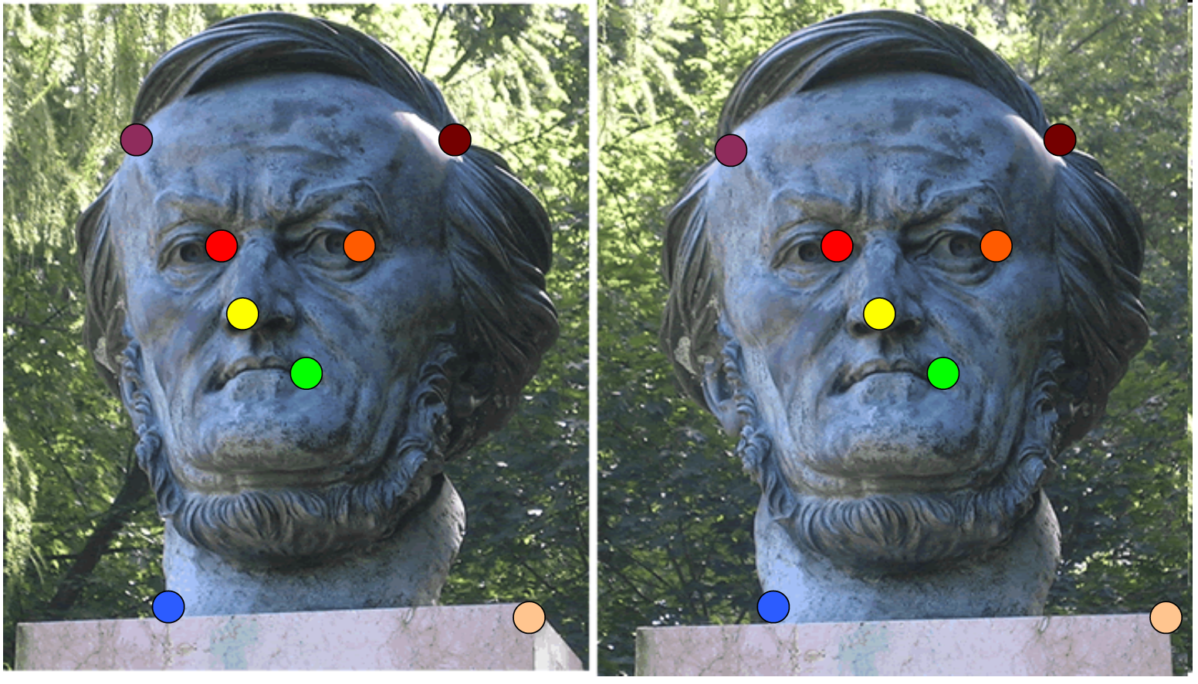
Estimating F

Slide 33
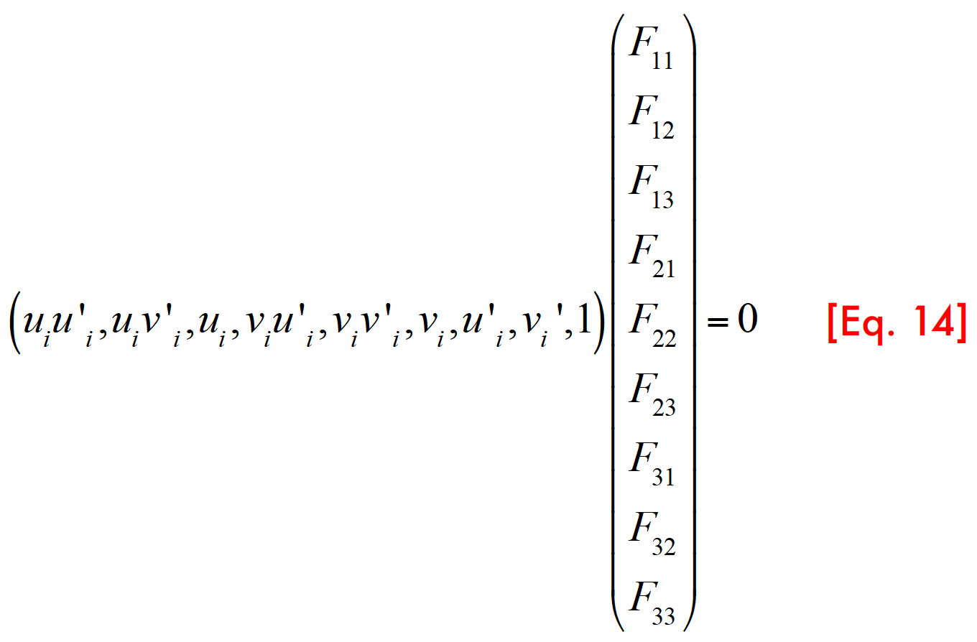
Estimating F

Slide 34
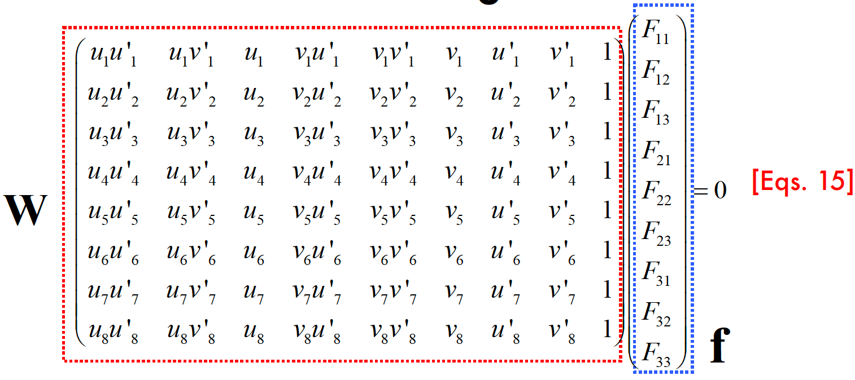
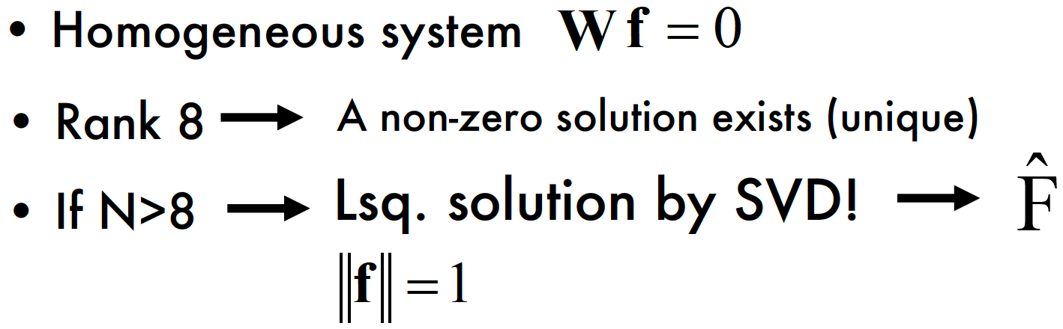
Estimating F

Slide 35
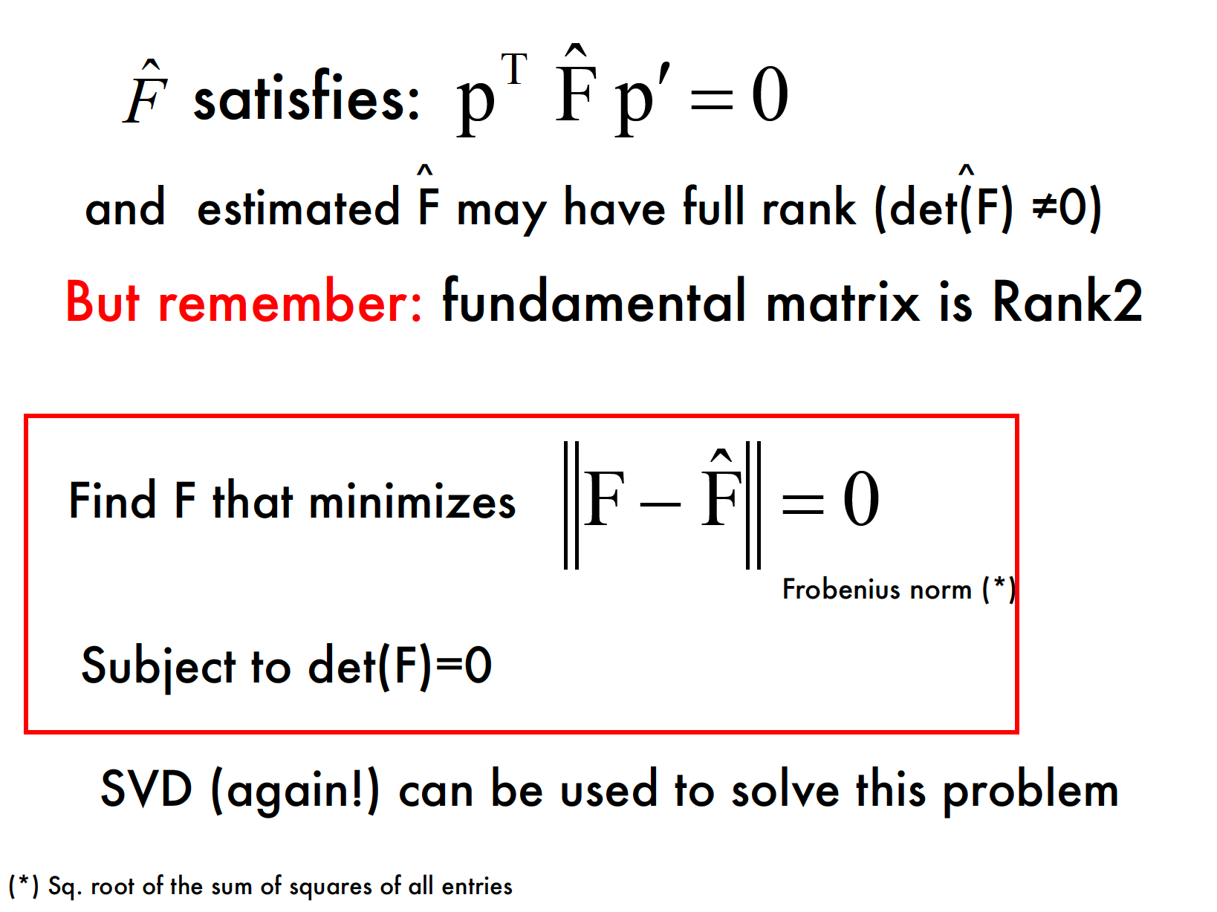
rank(F)=2

Slide 36
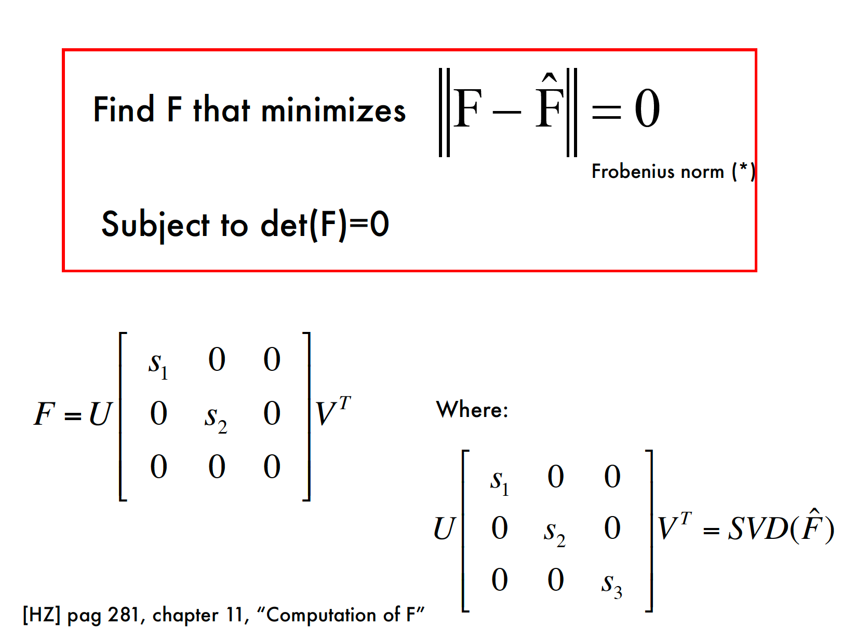

Slide 37
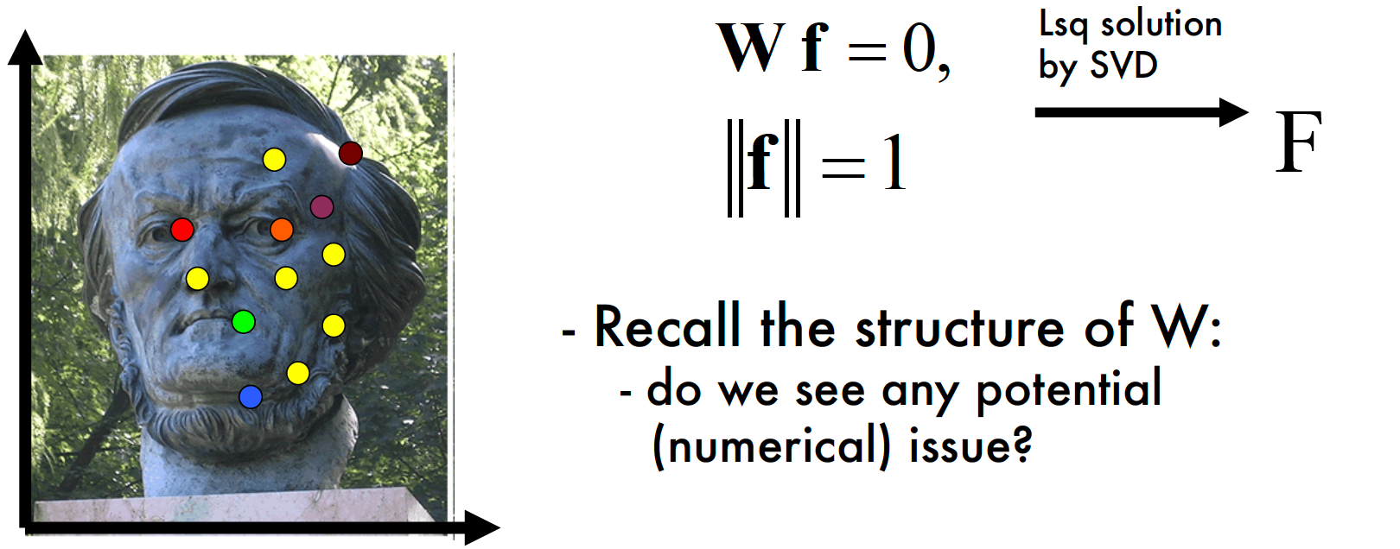
Problems with the 8-Point Algorithm

Slide 38
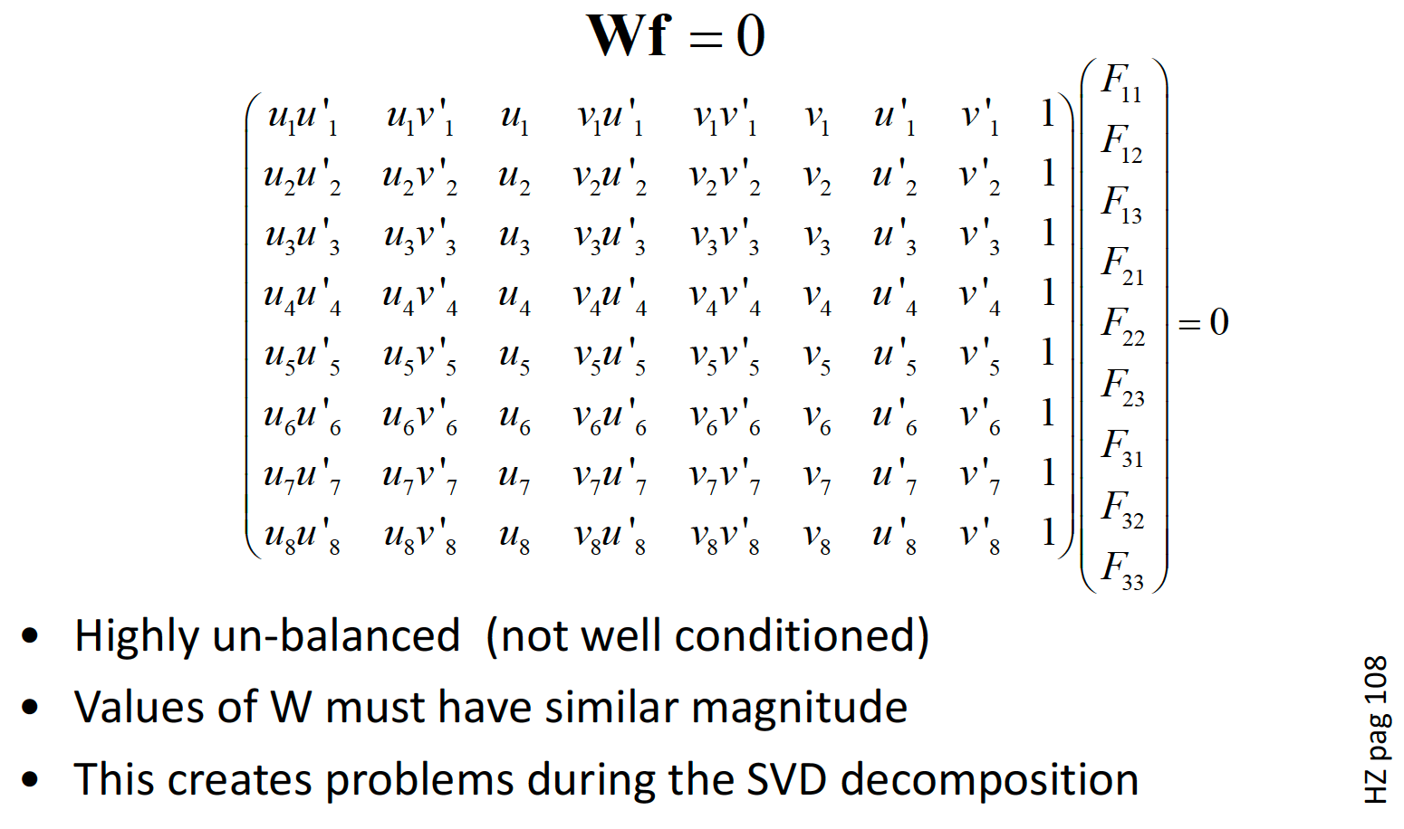
Problems with the 8-Point Algorithm

Slide 39
Normalization
IDEA: Transform image coordinates such that the matrix W becomes better conditioned (pre-conditioning)
For each image, apply a transformation T (translation and scaling) acting on image coordinates such that:
Origin = centroid of image points
Mean square distance of the image points from origin is ~2 pixels

Slide 40
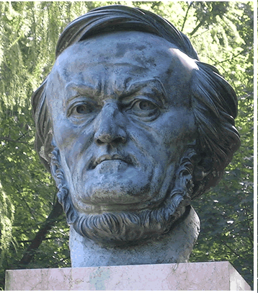



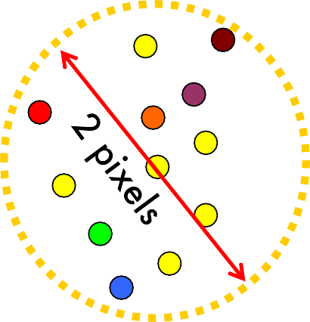





Example of normalization
T
Coordinate system of the image before applying T
Coordinate system of the image after applying T
Origin = centroid of image points
Mean square distance of the image points from origin is ~2 pixels

Slide 41
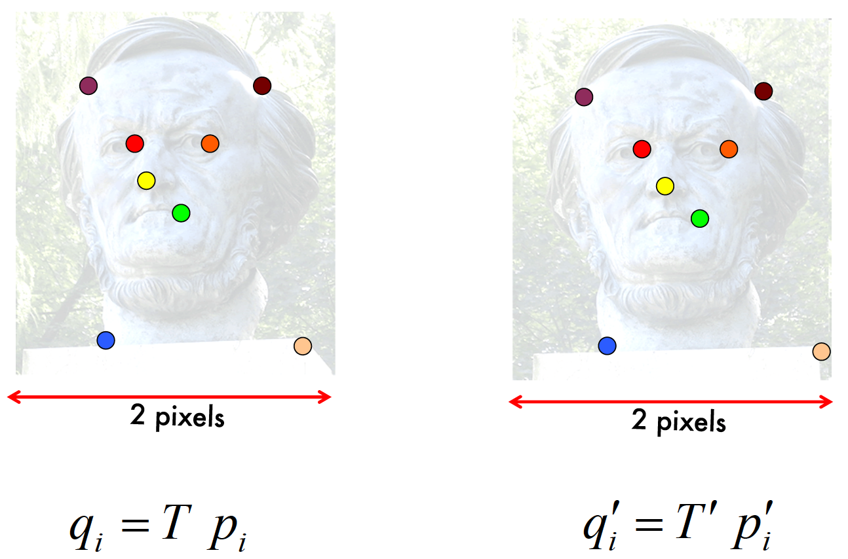
Normalization

Slide 42
The Normalized Eight-Point Algorithm
Compute T and T’ for image 1 and 2, respectively
Normalize coordinates in images 1 and 2:
q_{i} = T p_{i}
q_{i}′ = T ′ p_{i}′
2. Use the eight-point algorithm to compute F^{ˆ} from the
q
corresponding points q and q’ .
i
i
1. Enforce the rank-2 constraint: → F_{q}
such that:
q^{T} F q′ = 0
q
det( F_{q} ) = 0
2. De-normalize F :
F = T^{T} F T '
q
q

Slide 43
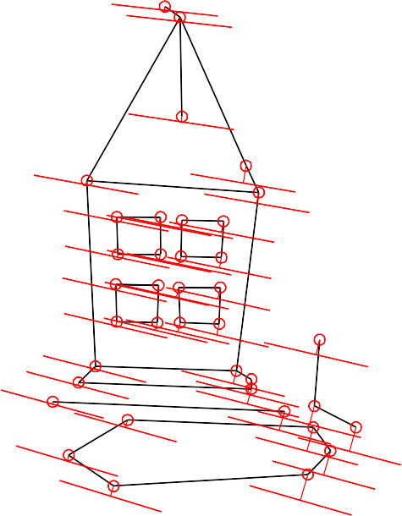
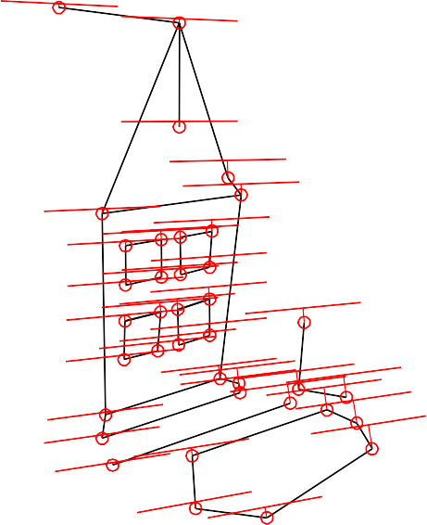
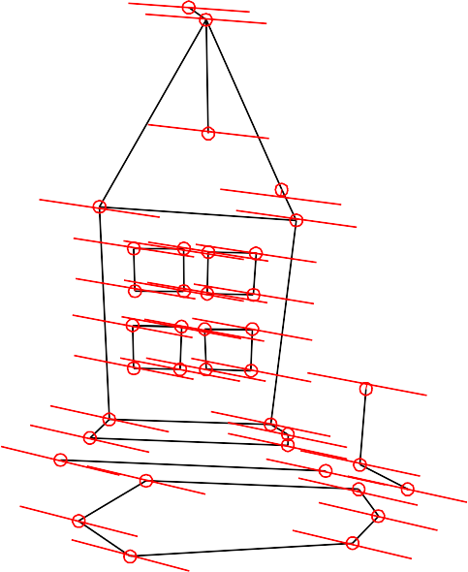
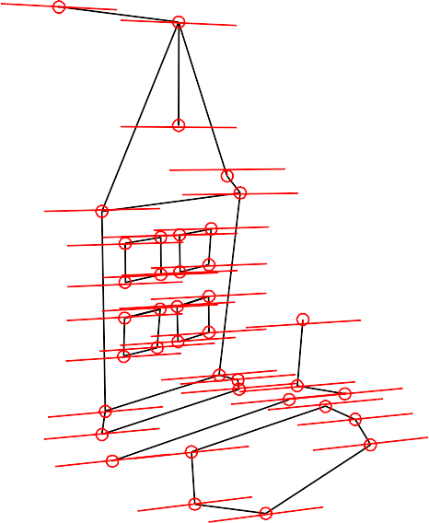
Mean errors: 10.0pixel 9.1pixel
Without normalization
With normalization
Mean errors: 1.0pixel 0.9pixel

